Slide 1

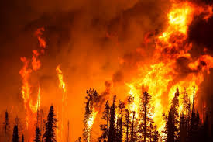
FIRE DETECTION SYSTEM USING OPENCV AND ML
NEIL GOGTE INSTITUTE OF TECHNOLOGY
Kachavanisingaram Village, Hyderabad, Telangana 500058.
PRESENTED BY :-
KASHETTY ANEESH 245320748020
M RUTHWIK 245320748027
K PRANEETH KUMAR 245320748306
Batch-21
UNDER THE GUIDANCE OF:-
Mrs. S. SWAPNA
ASSISTANT PROFESSOR
Department of CSE(AIML)

Slide 2
TABLE OF CONTENTS
INTRODUCTION
EXISTING SYSTEM
PROPOSED SYSTEM
OPERATING ENVIRONMENT
FUNCTIONAL REQUIREMENTS
SYSTEM DESIGN
RESULTS
CONCLUSION
FUTURE SCOPE
REFERENCES

Slide 3
INTRODUCTION
Fire plays a major role in providing light and heat but it is very dangerous as it spreads rapidly.
So we need to be more cautious in monitoring it.
Our project aimed to detect fire by using the image processing technology that will alert victims by early detection of fire.
We use supervised learning to build a model that recognizes fire in real time through cameras.

Slide 4
EXISTING SYSTEM
Most of the existing “Fire Detection Systems” consists of only hardware i.e the detection sensors.
They have some limitations and designed to sense fire with the smoke, which is limited to areas.
To reduce limitations and to optimize with new technology, this project is proposed.

Slide 5
LIMITATIONS
They only detect fire & smoke then alert just by an alarm.
So many sensors are required as they can cover a limited distance about 5-7ft.
It can be fooled easily.

Slide 6
PROPOSED SYSTEM
In our proposed system we are trying to develop a detector which detects the fire and alerts the user.
The user has to give his Camera access to the system where it takes the real-time video as input and pre-processes the data to the model where it detects the fire(if any found) and plays the alarm which alerts the victims, this system also sends an alert to the user or nearby Fire Station by an email or SMS.

Slide 7
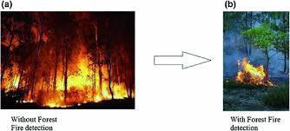
ADVANTAGES OF PROPOSED SYSTEM
This system can detect fire in less reaction time than sensor fire detection.
Cost Efficient as all we need is cameras or drones
By detecting the fire in less reaction time the property loss decreases and evacuating time increases for victims.
Using the same we can implement new features in future.

Slide 8
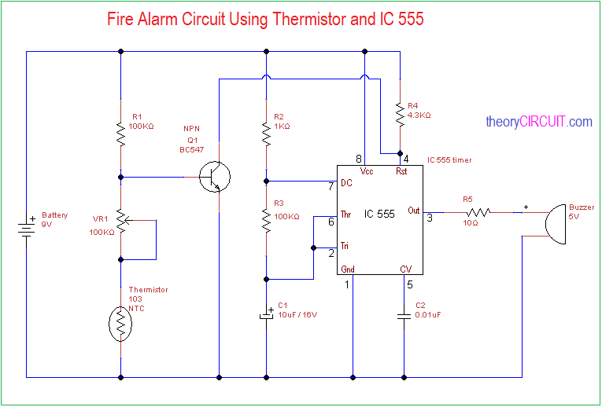
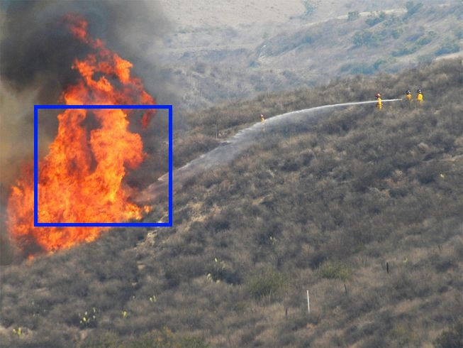
DIFFERENCES

Slide 9
OPERATING ENVIRONMENT
Software Requirements:
Operating System : Windows 7 (Min)
Back End : Python
Hardware Requirements:
Processor : Intel Pentium® i3 Core Processor (Min)
Speed : 2.9 GHz (Min)
RAM : 4 GB (Min)
Hard Disk : 8 GB (Min)

Slide 10
FUNCTIONAL REQUIREMENTS
User Functionality:
The user will be able to give camera access to the system.
Give the requirements to the Admin.
Admin Functionality:
The admin manages the system.
The admin can increase dataset size.
The admin can set the requirements as required by the user.
The admin can implement a better algorithm if at all a better algorithm is created in future.

Slide 11
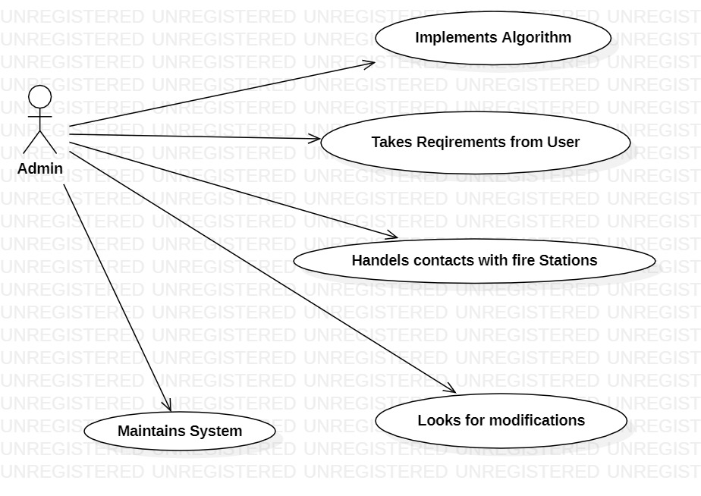
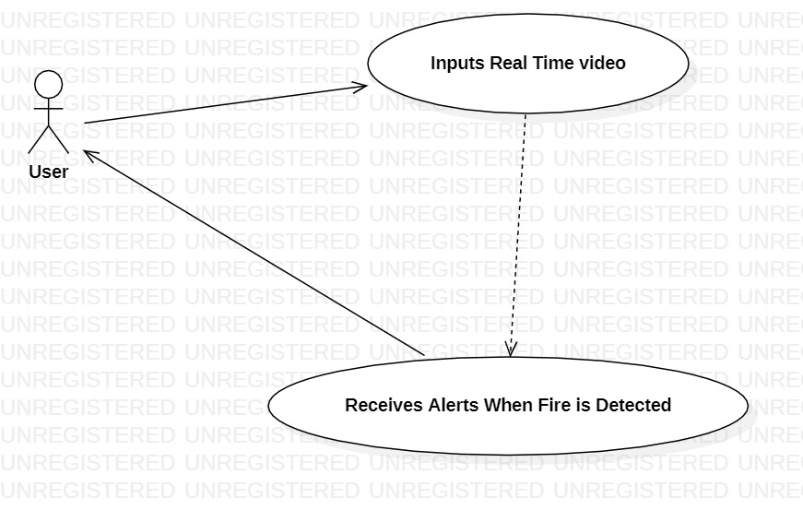
USECASE DIAGRAMS
SYSTEM DIAGRAMS

Slide 12
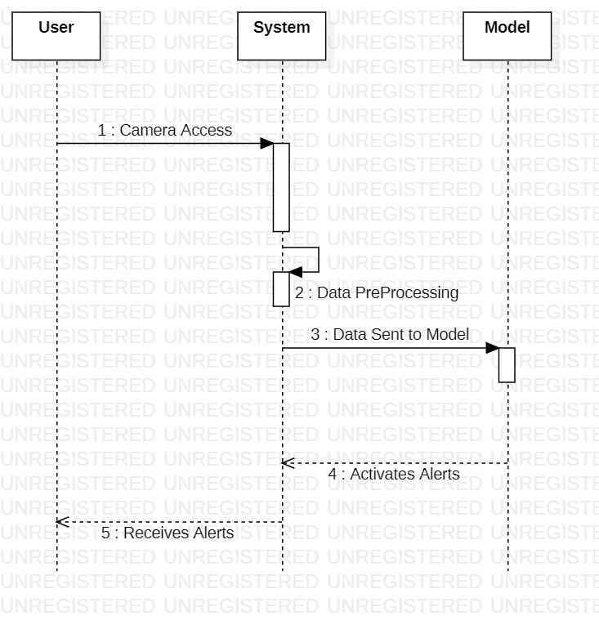
SEQUENCE DIAGRAM

Slide 13
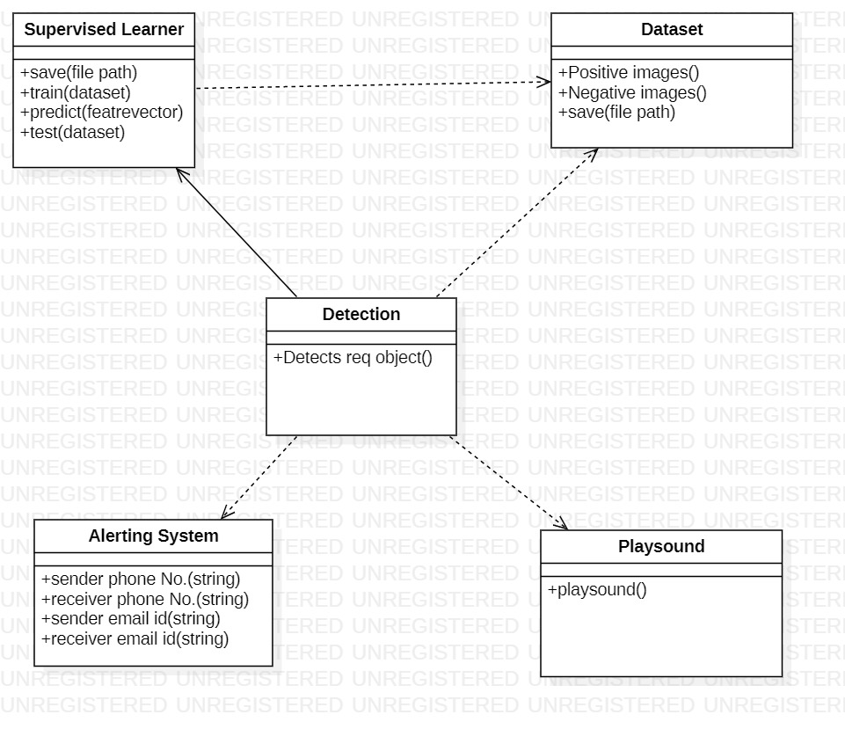
CLASS DIAGRAM

Slide 14
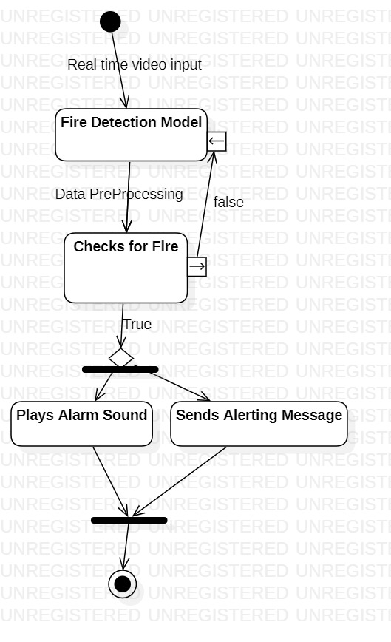
ACTIVITY DIAGRAM

Slide 15
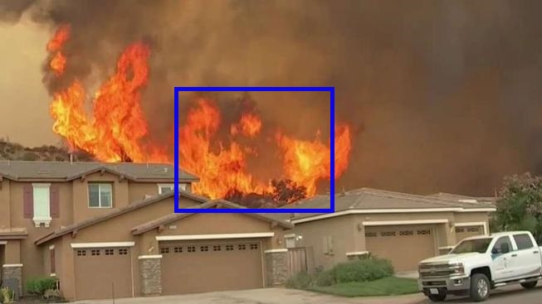

RESULTS
Fire Detected at ABC Chemical Factory, Nacharam X Road
Alert message received by Owner

Slide 16

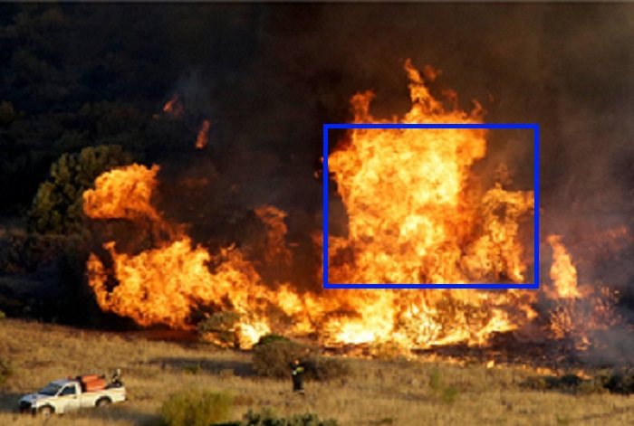
Fire Detected at ABC Rubber Factory, Nampally X Road
Alert message received by Fire Station

Slide 17


Alert message received by Fire Station
Alert message received by Owner

Slide 18
CONCLUSION
The main idea behind the fire detection and alerting system is to reduce the damage and Causalities cause by the fire accidents, this project is proposed in such a way that the fire is detected at the earliest and alerts the victims to evacuate the place, also sends message to the security chief or the Property Owner and also sends alert messages to the nearby fire stations.

Slide 19
FUTURE SCOPE
In future the model can be modified if a new emerging algorithm is emerged then that can be used to train the model only if, its reaction time is less when compared to the HAAR CASCADE algorithm. This model can be combined with other models to develop the organization.

Slide 20
CONCLUSION
The main idea behind the fire detection and alerting system is to reduce the damage and Causalities cause by the fire accidents, this project is proposed in such a way that the fire is detected at the earliest and alerts the victims to evacuate the place, also sends message to the security chief or the Property Owner and also sends alert messages to the nearby fire stations.

Slide 21
REFERENCES
Existing System:
https://semiengineering.com/sensors-in-fire-detection/
Datasets:
https://www.kaggle.com/datasets/phylake1337/fire-dataset
OPEN CV:
https://docs.opencv.org/4.x/d9/df8/tutorial_root.html

Slide 22
Thank You!!!

